Slide 1
Cell Biology Lec (13 )
Cell signalling

Slide 2
Cell signalling
All cells, from prokaryotes through plants and animals, sense and react to stimuli in their environments that allow them to survive, adapt, and function in ways appropriate to the needs of the organism.
Signalling : Cell-cell communication via signals.
There are two types of signalling:
1- Extracellular signalling.
2- Intracellular signalling.

Slide 3
Cell signalling
Extracellular signalling:
The binding of extracellular signal molecules to either cell-surface receptors or intracellular receptors.
Most signal molecules are hydrophilic and are therefore unable to cross the plasma membrane directly; instead, they bind to cell-surface receptors, which in turn generate one or more signals inside the target cell.
Some small signal molecules, by contrast, diffuse across the plasma membrane and bind to receptors inside the target cell either in the cytosol or in the nucleus. Many of these small signal molecules are hydrophobic and nearly insoluble in aqueous solutions; they are therefore transported in the bloodstream and other extracellular fluids after binding to carrier proteins, from which they dissociate before entering the target cell.

Slide 4
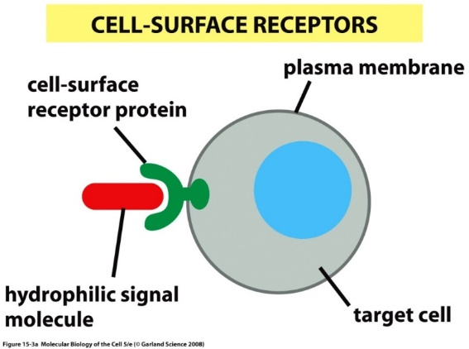
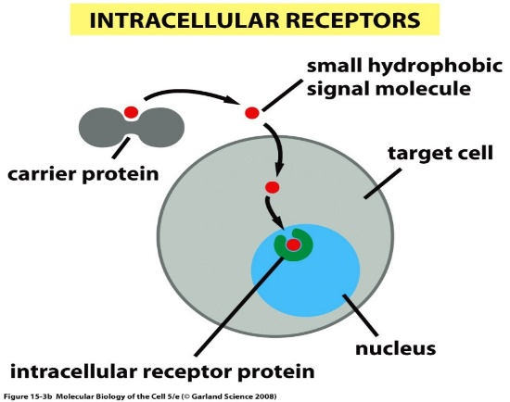
Cell signaling

Slide 5
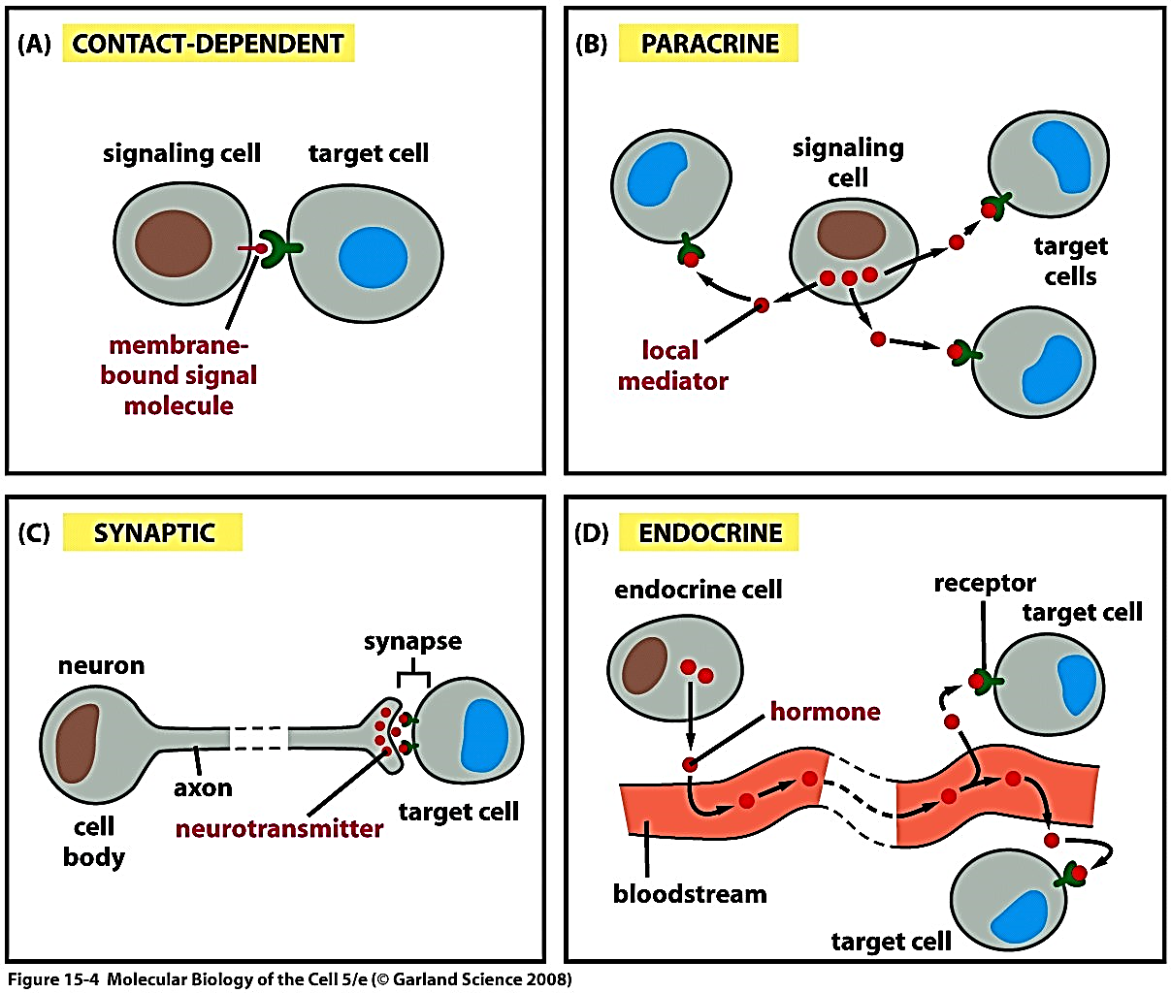
Cell signaling
Intercellular signalling:
Forms of intercellular signalling:
(A) Contact-dependent signalling requires cells to be in direct membrane-membrane contact.

Slide 6
Cell signalling
(B) Paracrine signalling depends on signals that are released into the extracellular space and act locally on neighbouring cells.

Slide 7
Cell signalling
(C) Synaptic signalling is performed by neurons that transmit signals electrically along their axons and release neurotransmitters at synapses, which are often located far away from the cell body.

Slide 8
Cell signalling
(D) Endocrine signalling depends on endocrine cells, which secrete hormones into the bloodstream that are then distributed widely throughout the body.

Slide 9
Cell signalling
An animal cell's dependence on multiple extracellular signals. Each cell type displays a set of receptors that enables it to respond to a corresponding set of signal molecules produced by other cells. These signal molecules work in combinations to regulate the behaviour of the cell.
As shown here, an individual cell requires multiple signals to survive (blue arrows) and additional signals to divide (red arrow) or differentiate (green arrows). If deprived of appropriate survival signals, a cell will undergo a form of cell suicide known as programmed cell death, or apoptosis.

Slide 10
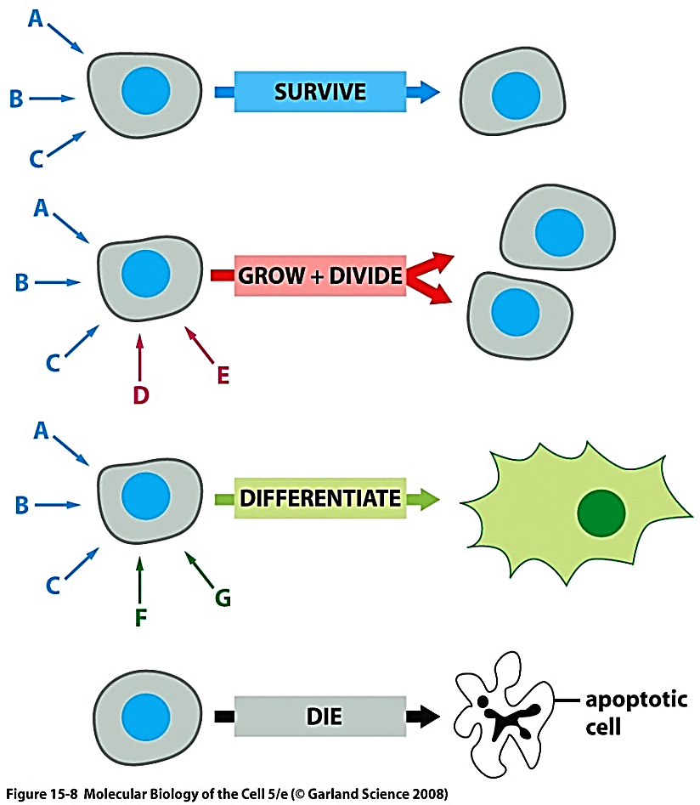
As shown here, an individual cell requires multiple signals to survive (blue arrows) and additional signals to divide (red arrow) or differentiate (green arrows). If deprived of appropriate survival signals, a cell will undergo a form of cell suicide known as programmed cell death, or apoptosis.

